Slide 1

Finding And Keeping a Job with the Free Version of ChatGPT
Use AI to Your Advantage
Notes:
https://careerservices.upenn.edu/preparing-effective-resumes/undergraduates-student-resume-samples/

Slide 2
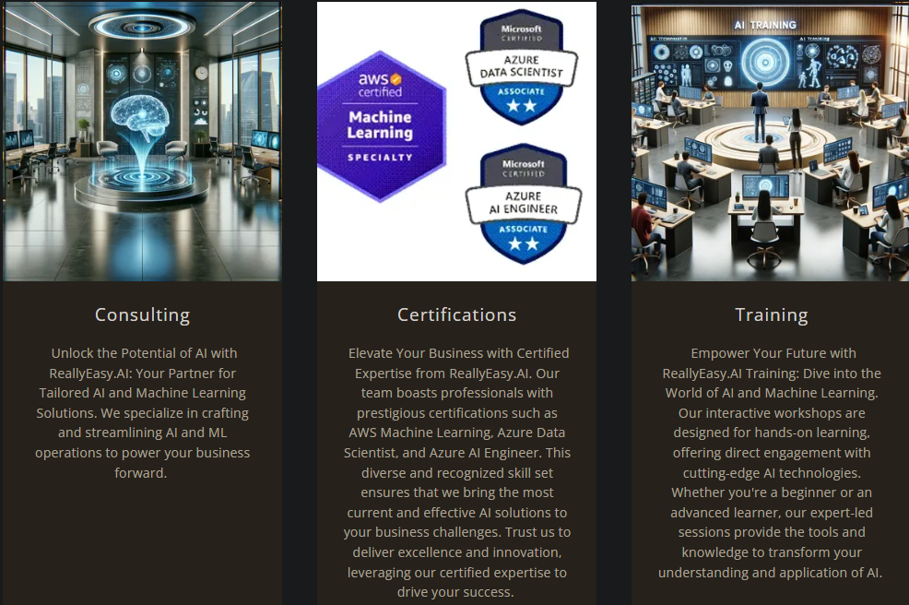

Slide 3

1.0 Mechanization, Steam, and Water Power
2.0 Mass Production and Electricity
3.0 Electronic / IT Systems and Automation
4.0 Cyber Physical Systems and
Artificial Intelligence
Notes:
https://www.forbes.com/sites/forbescoachescouncil/2023/10/30/generative-agile-leadership-what-the-fourth-industrial-revolution-needs/

Slide 4
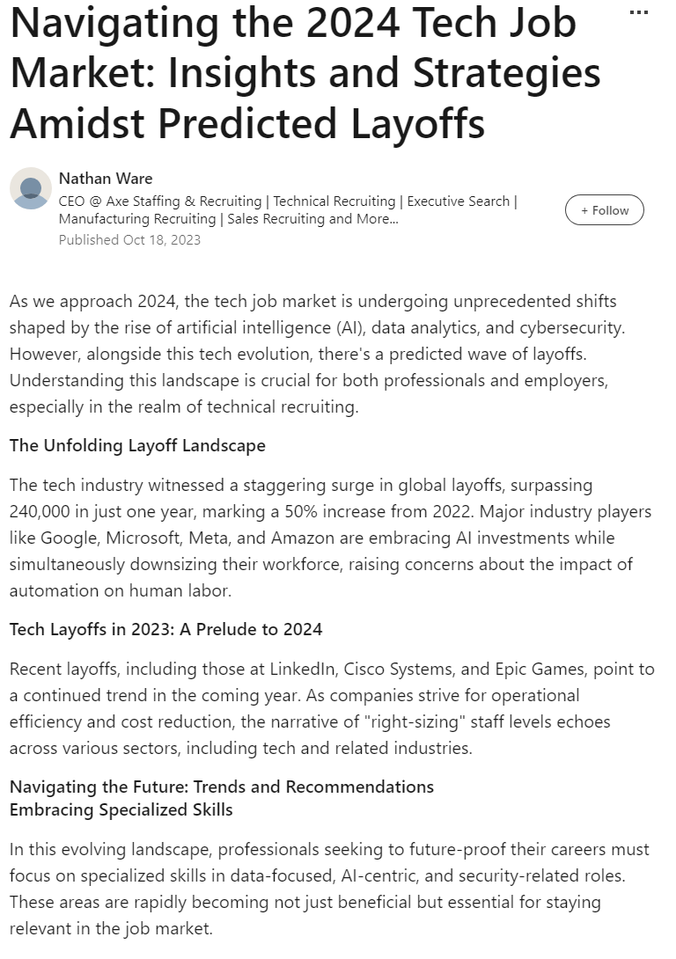
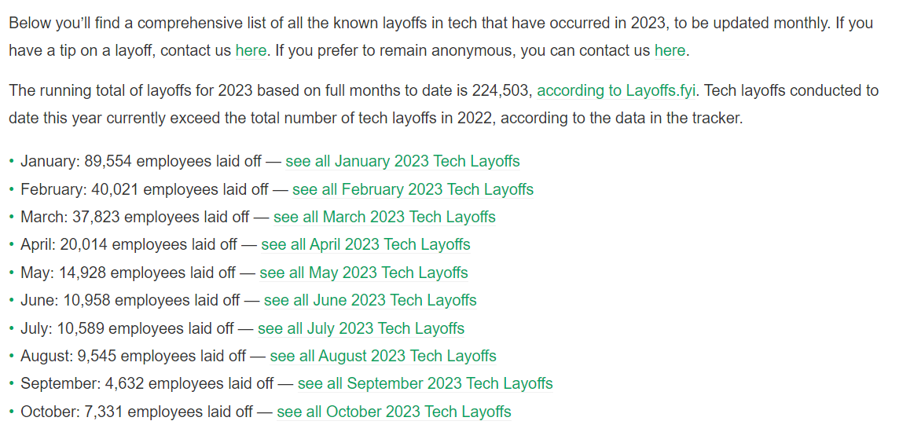
The Tech Job Market is Brutal Right Now
Notes:
https://www.linkedin.com/pulse/navigating-2024-tech-job-market-insights-strategies-amidst-ware

Slide 5
"Some people can read 'War and Peace' and come away thinking it's a simple adventure story.
Others can read the ingredients on a chewing gum wrapper and unlock the secrets of the universe."
Gene Hackman as Lex Luthor - Superman the Movie (1978)
Notes:
https://en.wikipedia.org/wiki/Superman_(1978_film)

Slide 6
Chat Gpt (Free version)
Your first Chewing gum wrapper, Sort Of

Slide 7
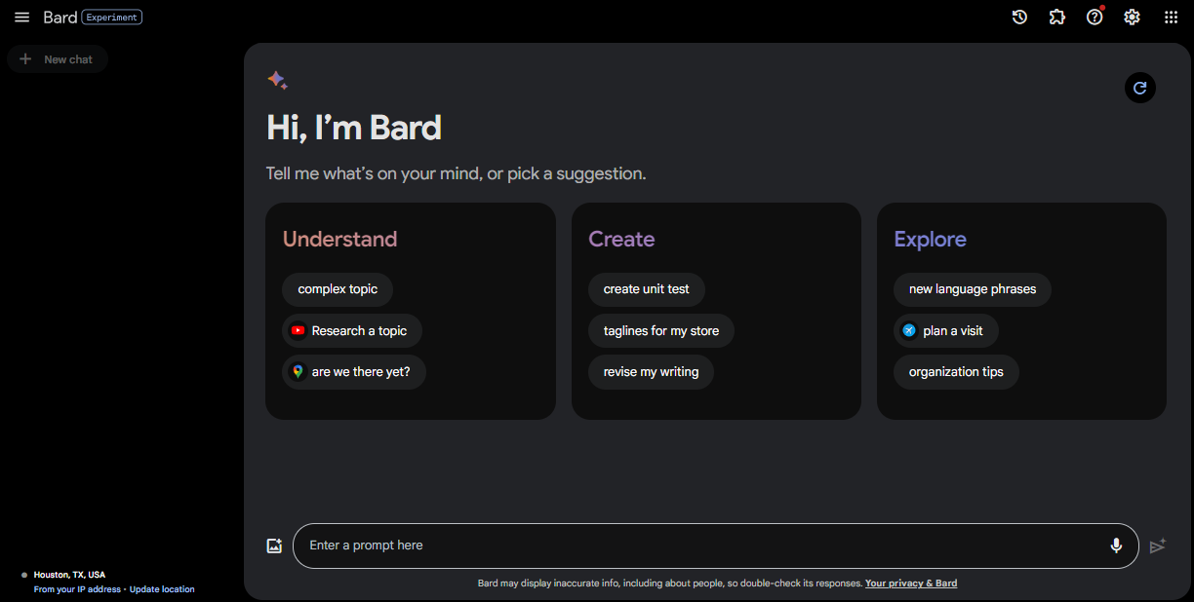
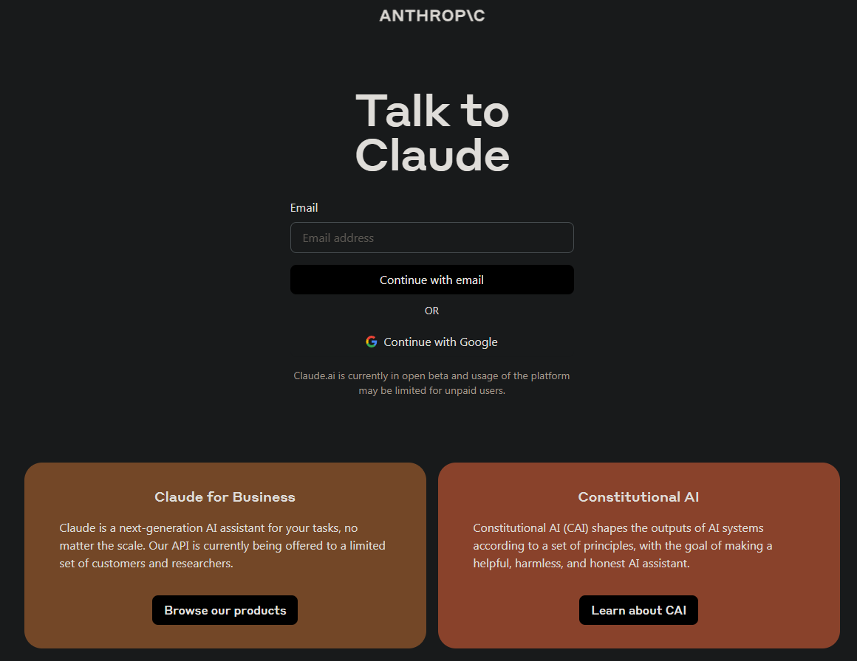
Not The Only Game in Town
Notes:
https://bard.google.com/chat
https://claude.ai/login

Slide 8
Why Chat GPT?
Easy to use
The de facto leader in the chat space
Low barrier to entry (Free)
Packed with features (especially Plus)
Widely known, recognized skill (Prompt Engineering)

Slide 9
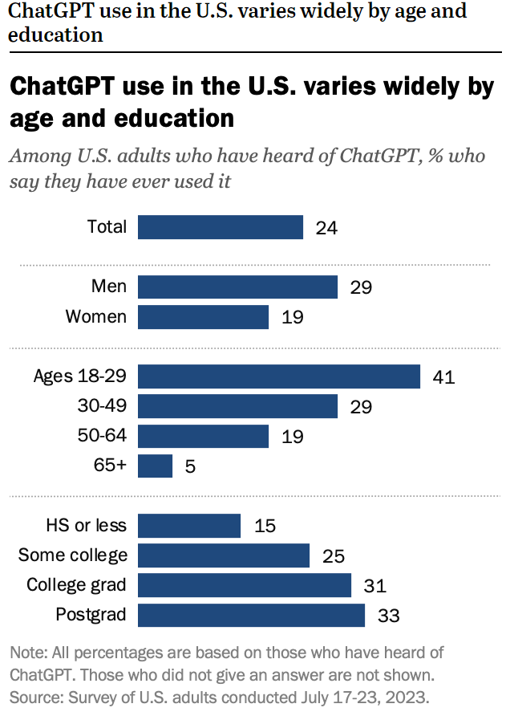
Notes:
https://www.pewresearch.org/short-reads/2023/08/28/most-americans-havent-used-chatgpt-few-think-it-will-have-a-major-impact-on-their-job/

Slide 10
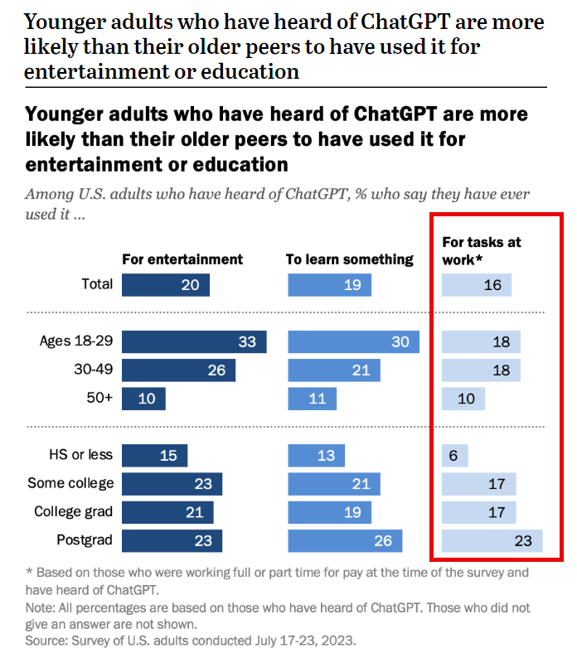
Notes:
https://www.pewresearch.org/short-reads/2023/08/28/most-americans-havent-used-chatgpt-few-think-it-will-have-a-major-impact-on-their-job/

Slide 11
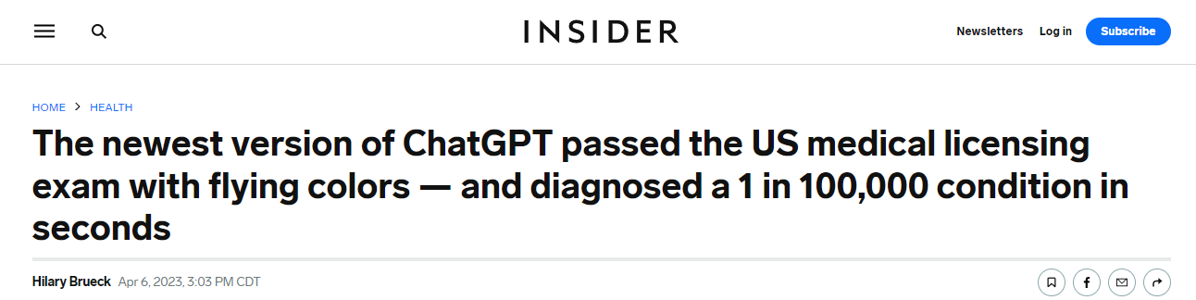
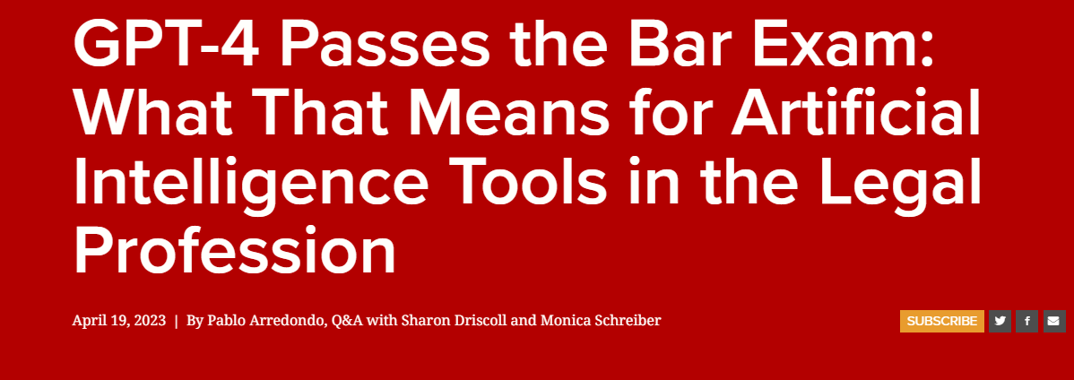
Notes:
https://www.insider.com/chatgpt-passes-medical-exam-diagnoses-rare-condition-2023-4
https://law.stanford.edu/2023/04/19/gpt-4-passes-the-bar-exam-what-that-means-for-artificial-intelligence-tools-in-the-legal-industry/

Slide 12
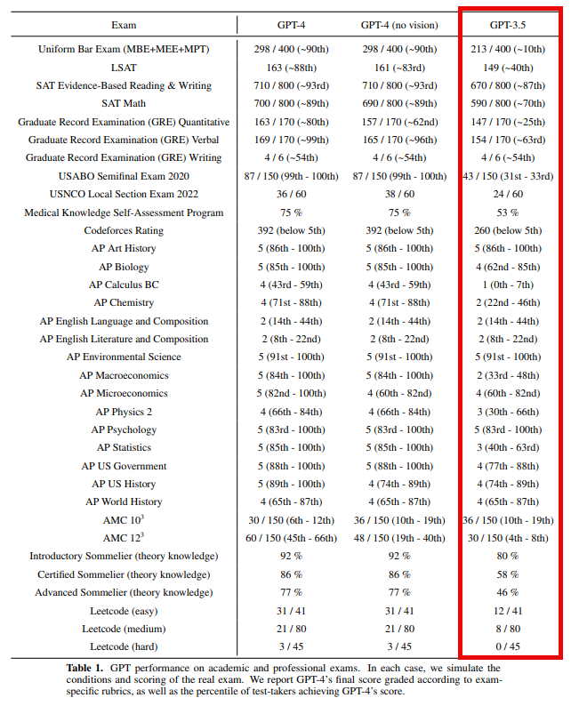
Notes:
https://cdn.openai.com/papers/gpt-4.pdf

Slide 13
Use the website, Get the mobile App
Website - https://chat.openai.com/
Mobile
Android - https://play.google.com/store/apps/details?id=com.openai.chatgpt&hl=en_US&gl=US&pli=1
iPhone - https://apps.apple.com/us/app/chatgpt/id6448311069

Slide 14
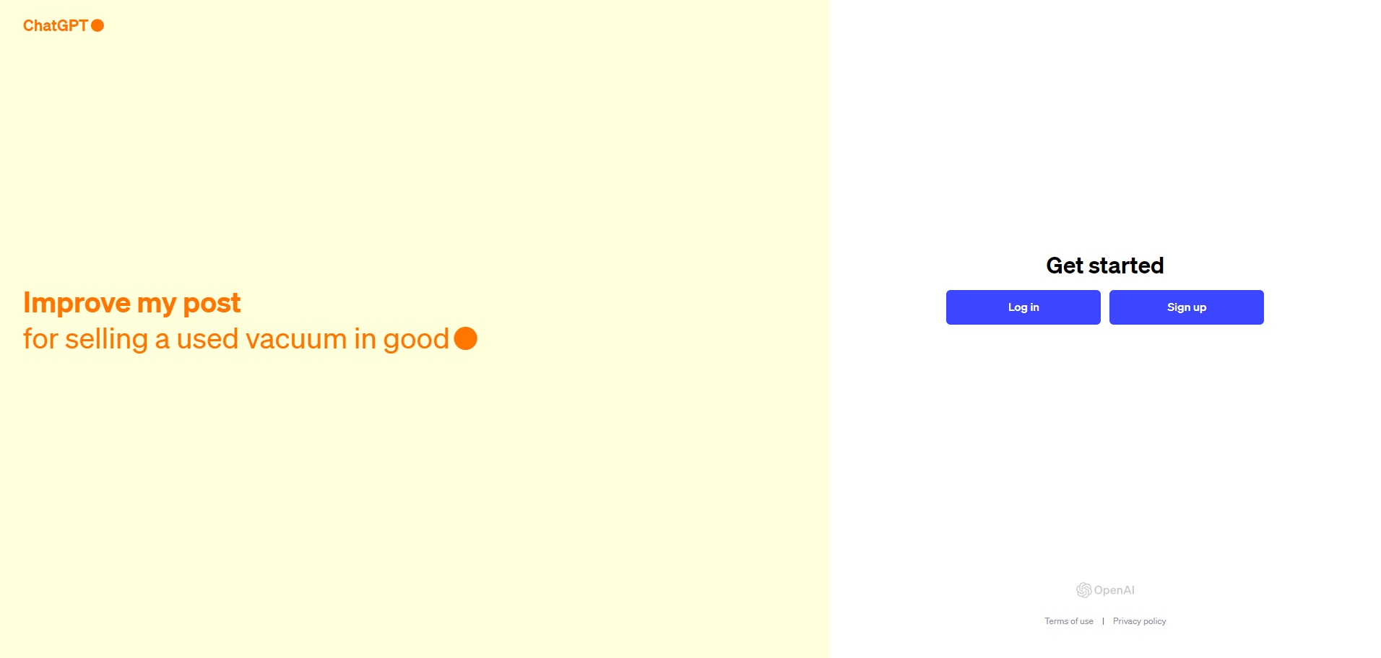
Signing Up for ChatGPT

Slide 15
Using ChatGPT to Find, Get, and Keep a Job
Make the Most of Your AI Time Investment

Slide 16

Personas
Making Sure You Have the Right Expert

Slide 17
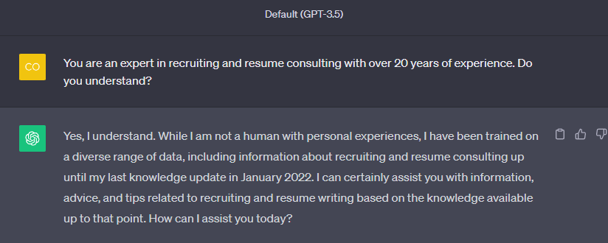
Personas
Notes:
https://platform.openai.com/docs/guides/gpt-best-practices/tactic-ask-the-model-to-adopt-a-persona
https://arxiv.org/pdf/2302.11382.pdf

Slide 18

Resume Advice
Make Sure Your Resume is Up To Speed

Slide 19
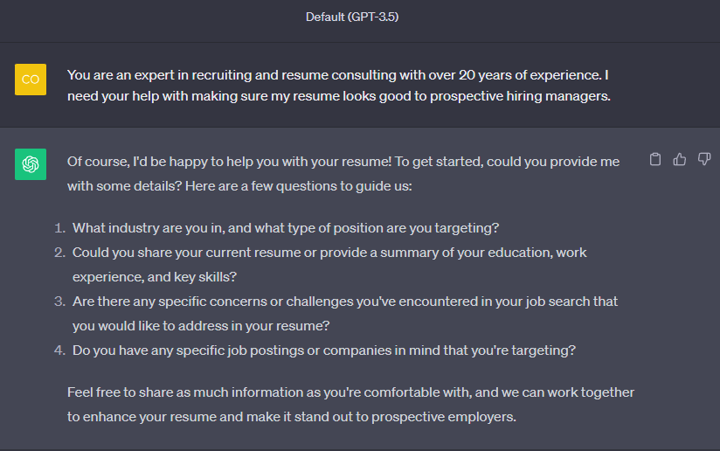
Resume Advice

Slide 20

Cover Letters
Never, Ever Apply without a Cover Letter

Slide 21
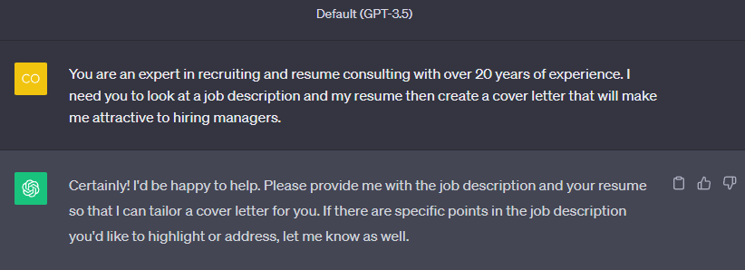
Cover Letters

Slide 22

Portfolio Building
Show Off Your Skills

Slide 23

Portfolio Building

Slide 24

Interview Prep
Ace the Interview with AI

Slide 25
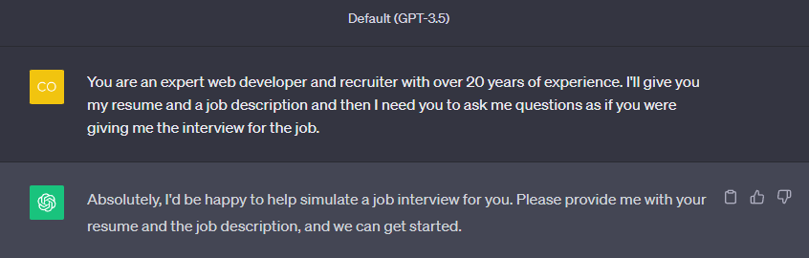
Interview Prep

Slide 26

On The Job
AI Doesn’t End Once You Get the Job

Slide 27
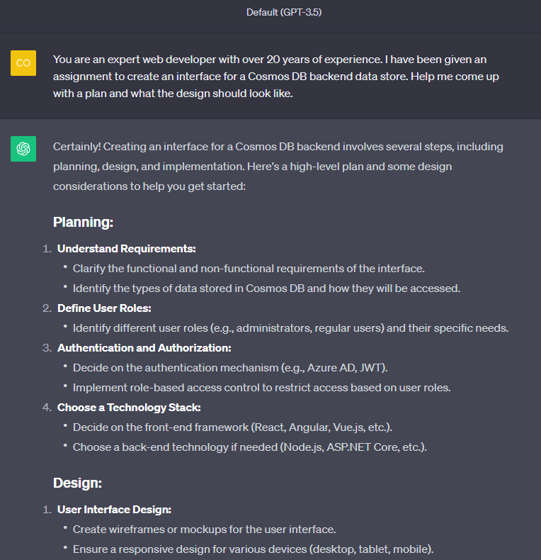
On the Job

Slide 28

Understanding Difficult Concepts
Getting Your Head around a Subject

Slide 29
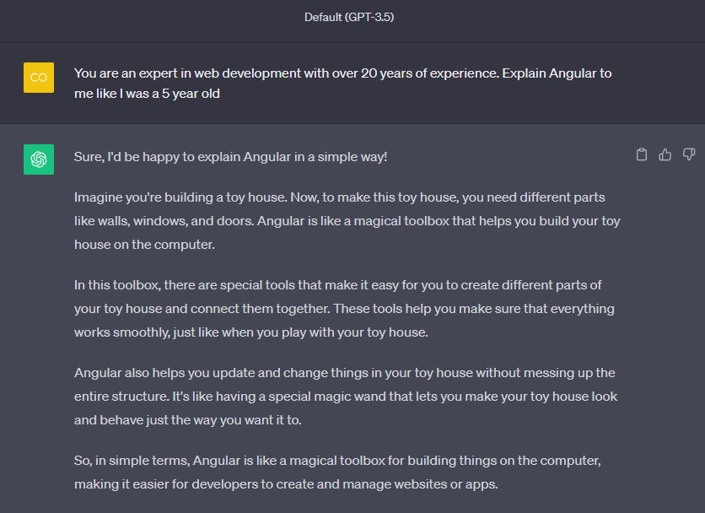
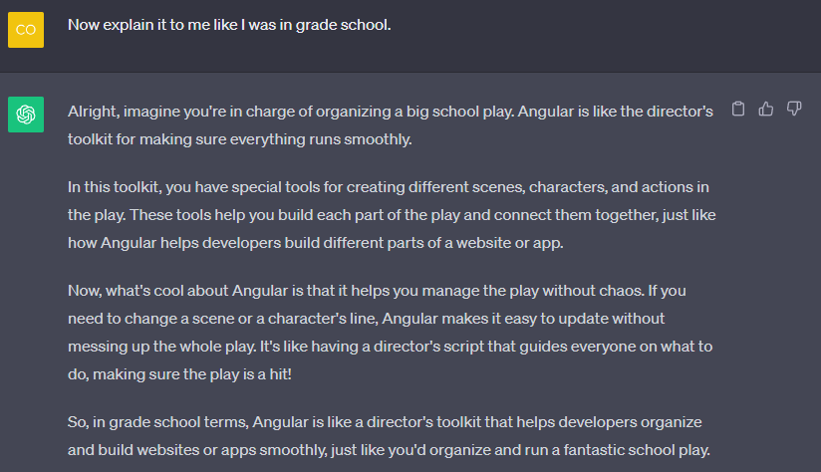
Understanding Difficult Concepts

Slide 30

Notes:
Good luck out there! You can do it!

